Slide 1


Interaction of Thoughts:
Towards Mediating Task Assignment in Human-AI Cooperation
with a Capability-Aware Shared Mental Model (CASMM)
CHI 2023
Ziyao He¹ Yunpeng Song¹ Shurui Zhou² Zhongmin Cai¹
¹Xi’an Jiaotong University ²Unviersity of Toronto
Notes:
Hello, everyone, I’m Ziyao He, a PhD student from Xi’an Jiaotong University, China, today I will present you my work: Interaction of Thoughts: Towards Mediating Task Assignment in Human-AI Cooperation with a Capability-Aware Shared Mental Model. This work is completed in cooperation with Dr. Yunpeng Song and Zhongmin Cai from Xi’an Jiaotong University and Dr. Shurui Zhou from University of Toronto.

Slide 2







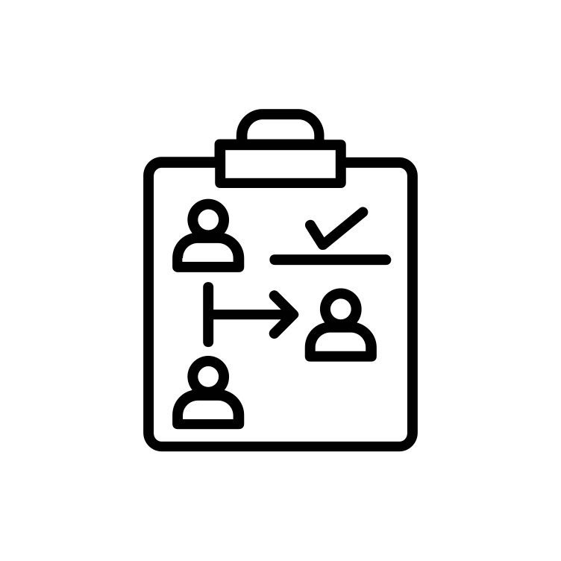









Task Assignment Based Human-AI Cooperation
Risks when straightly adopting AI’s answers
？
？
？
Automated
Driving
Medical
Diagnosis
Loan
Approval
When rely on AI? When to consult? Different People?
Notes:
AI, nowadays is so of development that they seem to be capable of performing anything if proper trained. However, the AI power is still under human supervision, and lots of tasks like automated driving, medical diagnosis, and loan approval are based on task assignment for human-AI cooperation. Because, for these tasks, high accuracy with low fault tolerance is required, we have to face risks when straightly adopting AI’s answers.
Also, for tasks like this, a specific problem we should consider is what part of the tasks we find really convinced for relying on AI to complete, and when is necessary to consult human. This, obviously should consider different human and AI’s capabilities. Also, if we want to build effective cooperation, we also should consider different users’ trust in AI technologies, this should also include making users be more aware of the AI’s abilities.

Slide 3
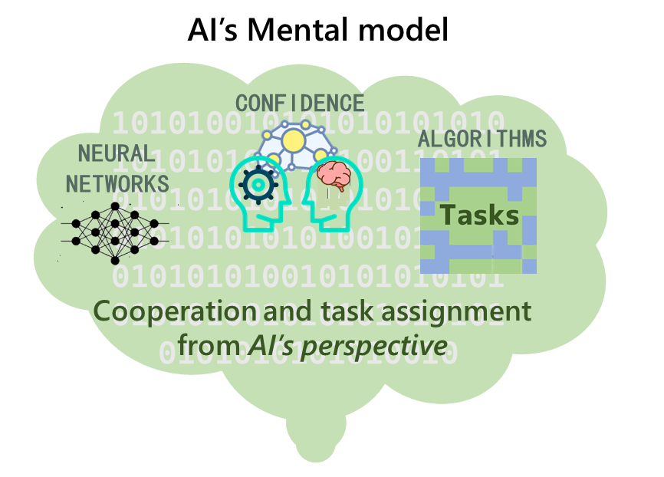
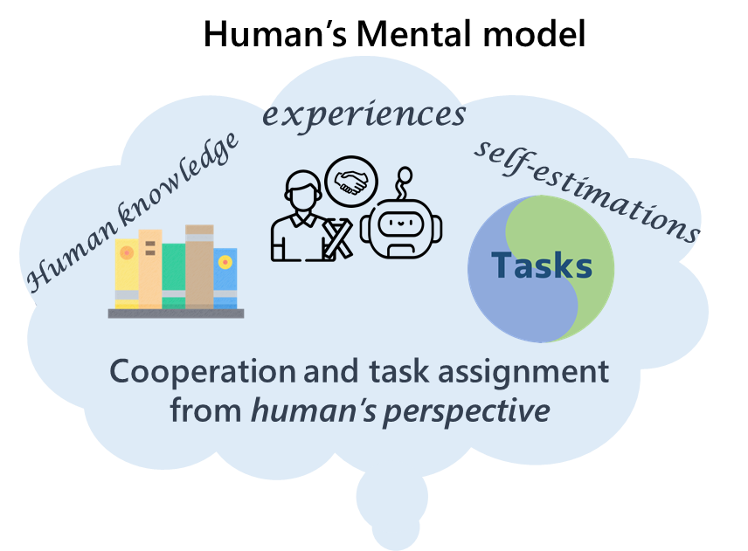


Some Related Works
Bryan Wilder et al. Learning to Complement Humans, IJCAI-20
Lucy Van Kleunen and Stephen Voida. Challenges in supporting social practices around personal data for long-term mental health management. UbiComp/ISWC 2019
Jean Y Song et al. FourEyes: Leveraging Tool Diversity as a Means to Improve Aggregate Accuracy in Crowd-sourcing. ACM TiiS 10, 1 (2019), 1–30.
……
Rui Zhang et al. " An Ideal Human" Expectations of AI Teammates in Human-AI Teaming. CSCW3 (2021)
Katy Ilonka Gero et al. Mental Models of AI Agents in a Cooperative Game Setting. CHI 2020
Felix Gervits et al. Toward Genuine Robot Teammates: Improving Human-Robot Team Performance Using Robot Shared Mental Models. AAMAS 2020
……
Notes:
Some works have already tried to solve this problem through AI’s decisions, they embedded average human’s capability as a factor other than AI’s confidence to train algorithms for deciding when to consult human. But we believe the task assignment should vary for different user, especially with different capabilities, such as for experts or novices. And still, human remains unaware of the AI’s real capabilities this way, they are only accepting the assigned works.
Some other works tries to include or collect human’s past experience, knowledge, or expectation of AI to refine the behavior of systems. But, deciding task assignment based on user’s experience or trust in our case, is obviously not objective because human will only have vague estimations of AI’s capabilities based on their experience with other AI, and then it will lead to an unfair task assignment.

Slide 4



Our Goal
A dynamic human-ai cooperative mechanism for task assignment
Based on a mutual understanding between human and AI
Expressed in a concise and quantitative form for computation and revision.
Shared Mental Model
Notes:
Considering all the above issues, we need a human-AI cooperative mechanism for task assignment that should be based on a mutual understanding between human and AI, and could be dynamically updated. If we further apply such a mechanism into system that actually works, it should moreover be expressed in a concise and quantitative form for computation and revision. And as far as we know, we are among the first ones that try to do it this way.
So, in our work, we propose to form a capability-aware shared mental model between humans and AI for task assignment.
So, what is the SMM in our work? Firstly, A mental model could be defined as a mental representation or explanation that someone uses to interact, describe, and predict the behavior of a particular substance or system. Then, the shared mental model ensures that every team member gets hold of each other’s mental model. During this process, the members share not only their completion results but also the reliability evaluations for each other (such as accuracy or confidence). It is shown to be effective in cognitive science for cooperation between humans.

Slide 5
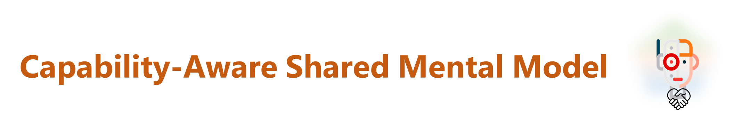
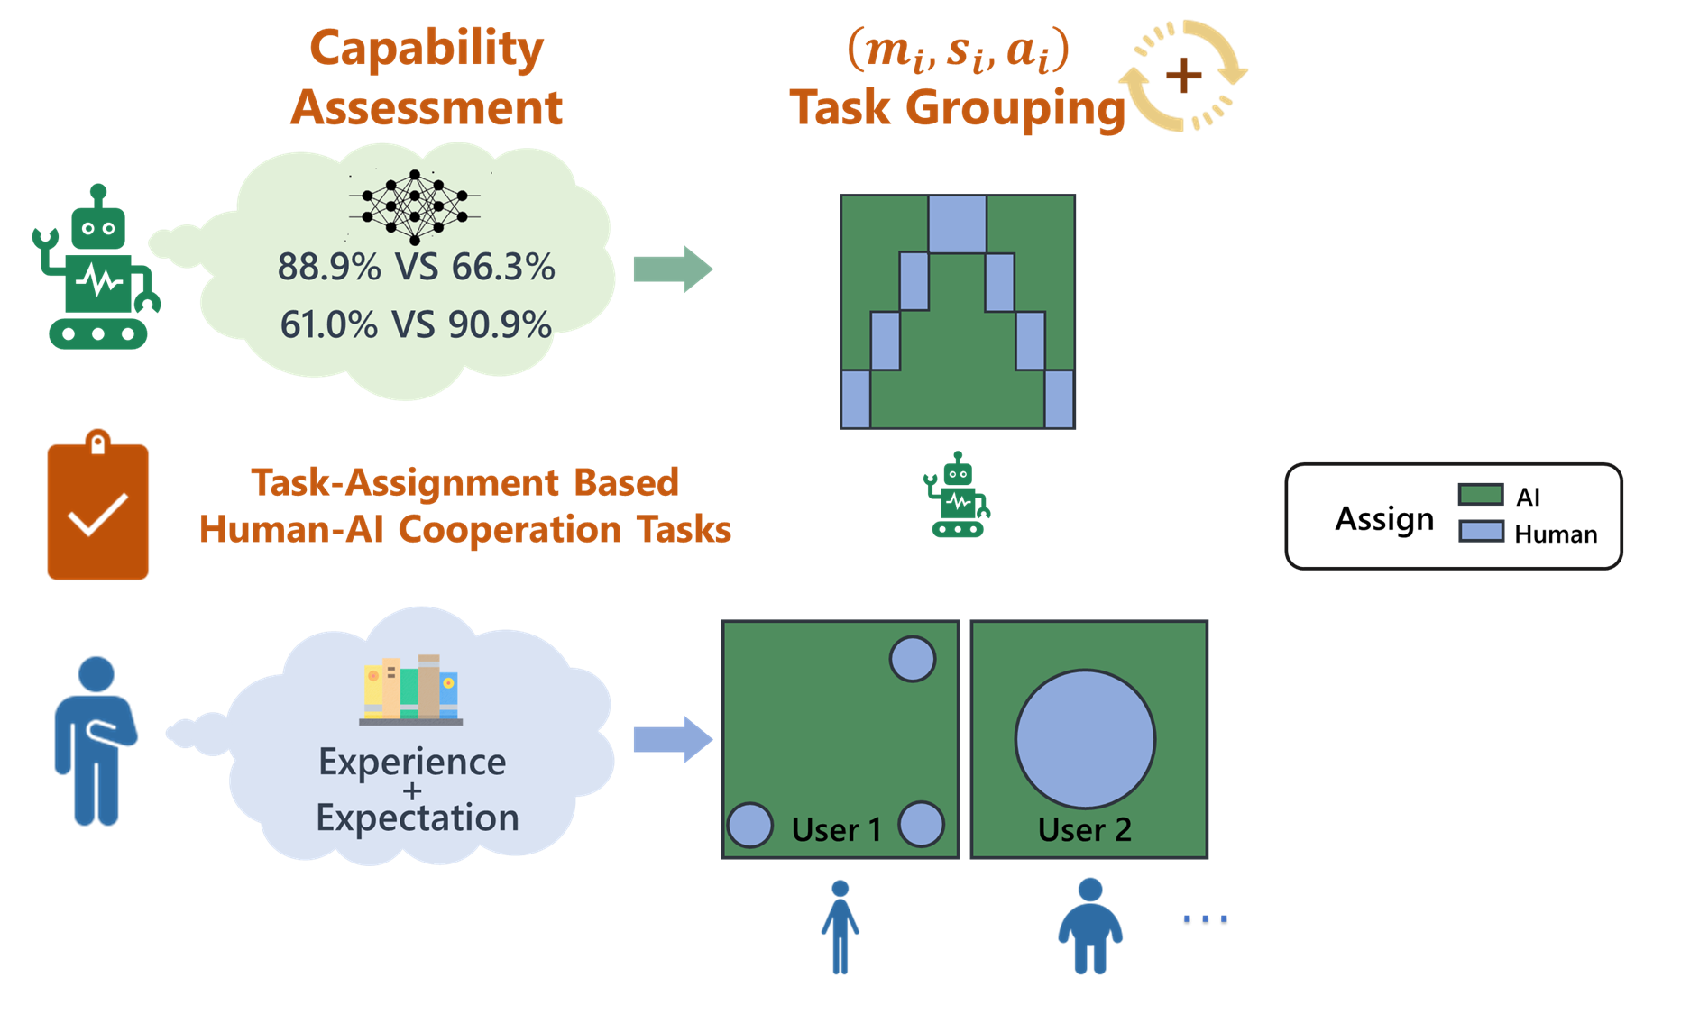
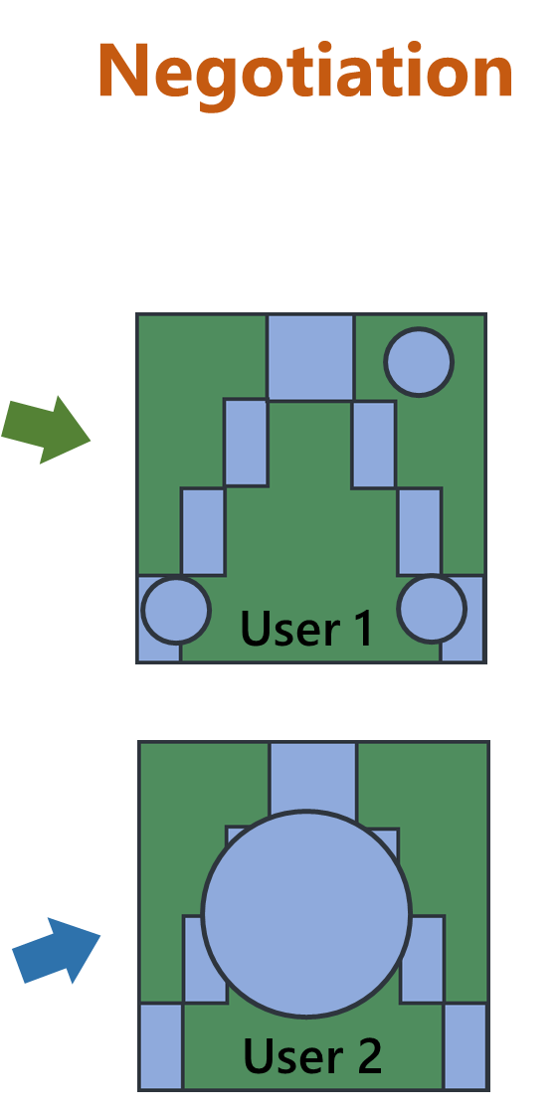
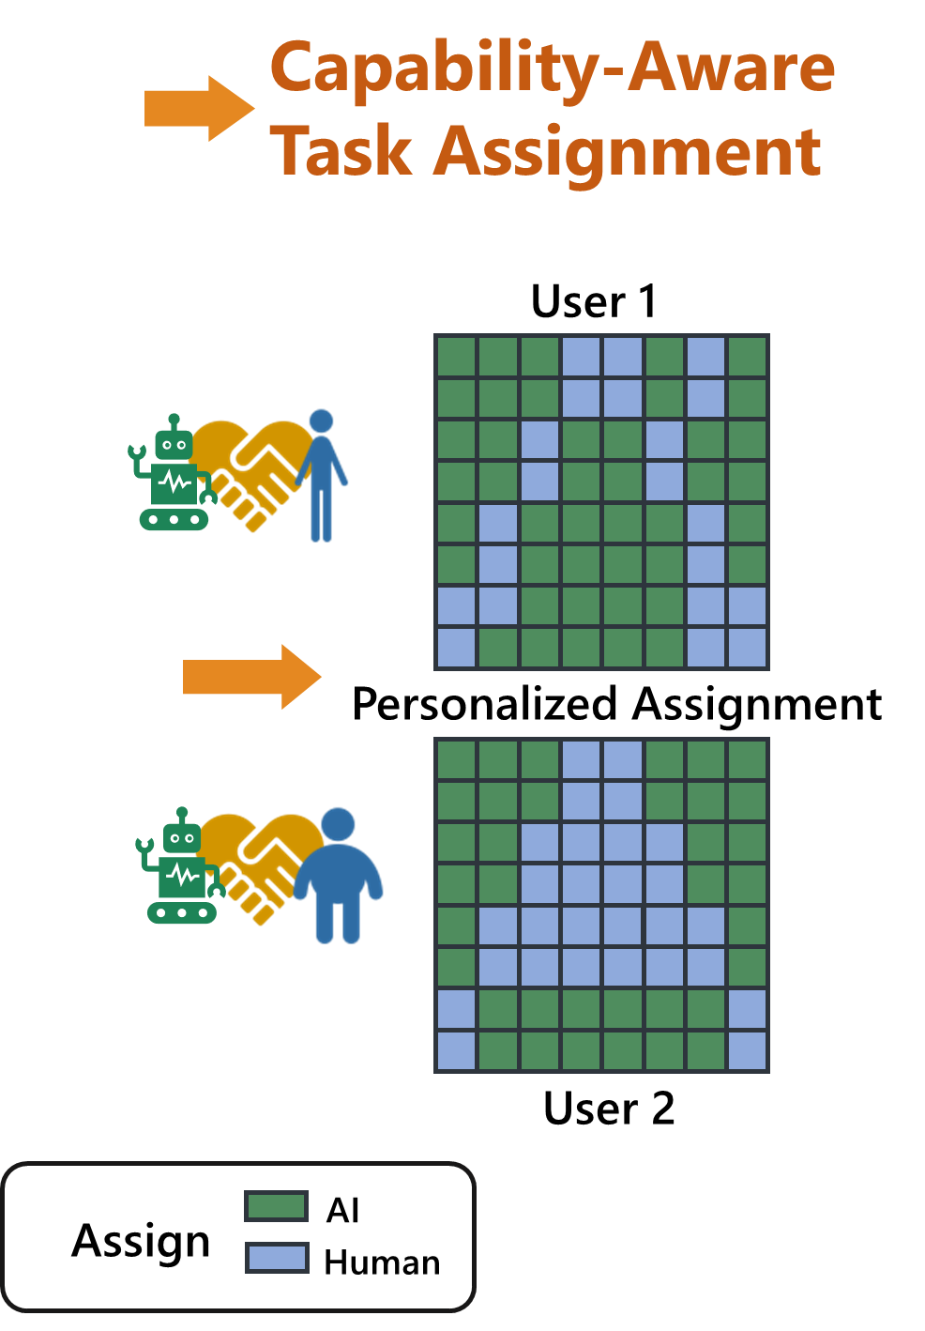
Notes:
Here is the overview of our shared mental model. In order to represent the task-specifc capability of human and AI in an understandable form for both human and AI for assigning tasks, we utilize a tuple (mi, si, ai) to represent the capability evaluation and task assignment opinions from human and AI. Here, mi denotes the team member (human or AI), si denotes the type of task in a specific scenario, and ai represents the performance of the team member handling such tasks. In this way, the tuples group the tasks in different scenarios and maps the specific tasks and the capability of each member. Then, we designed multiple-round negotiation methods to dynamically merge the task grouping ideas raised by human and AI. And then the system would assign the tasks based on the merged results. If either team member believes the task assignment does not reflect their real capabilities, our method will update the value of corresponding tuples to update the shared mental model.

Slide 6
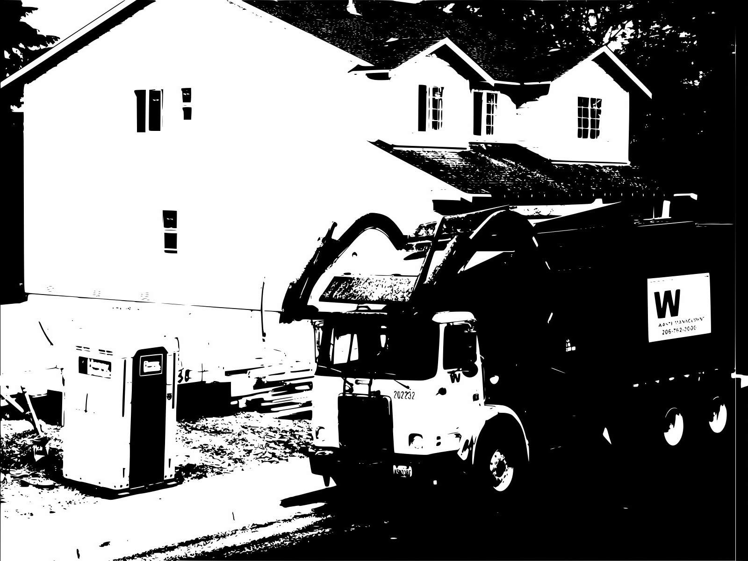

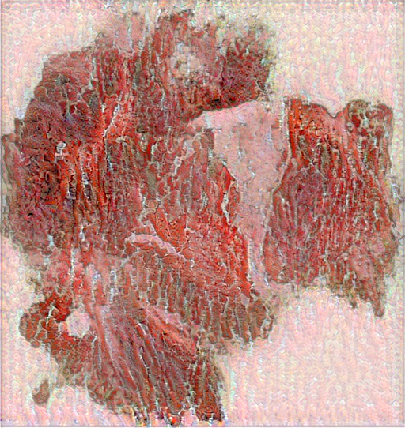
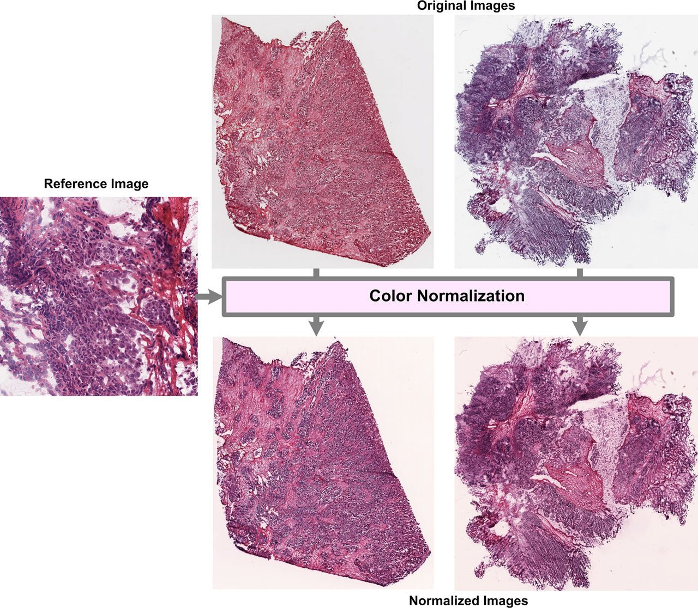
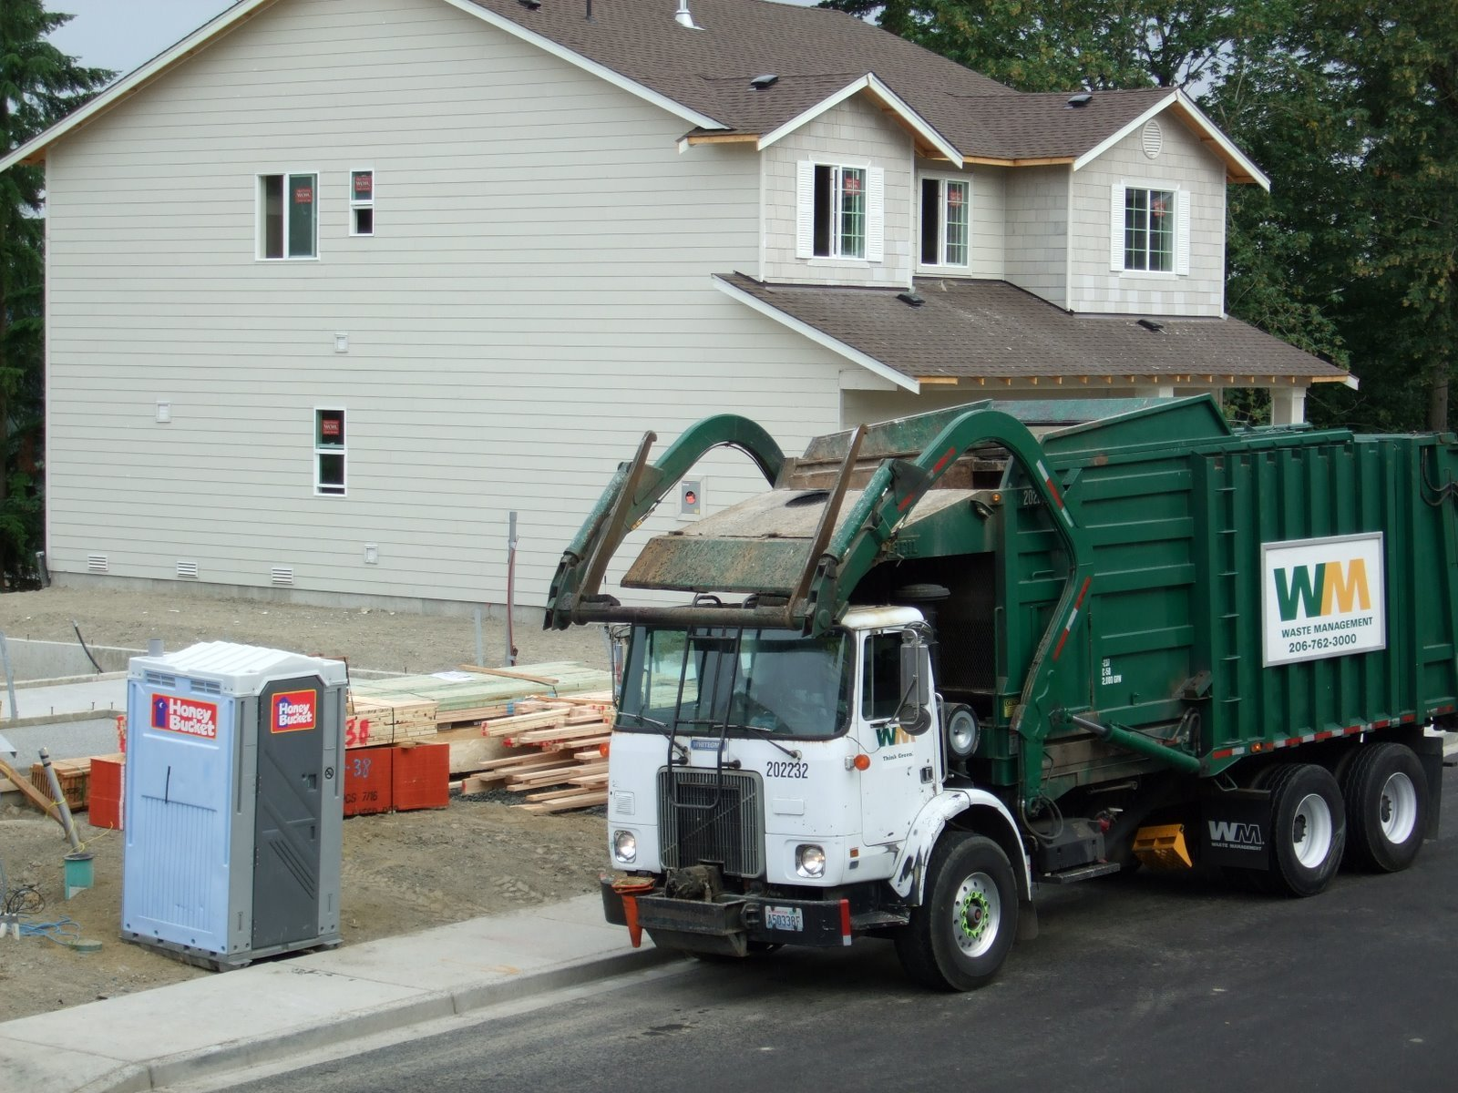
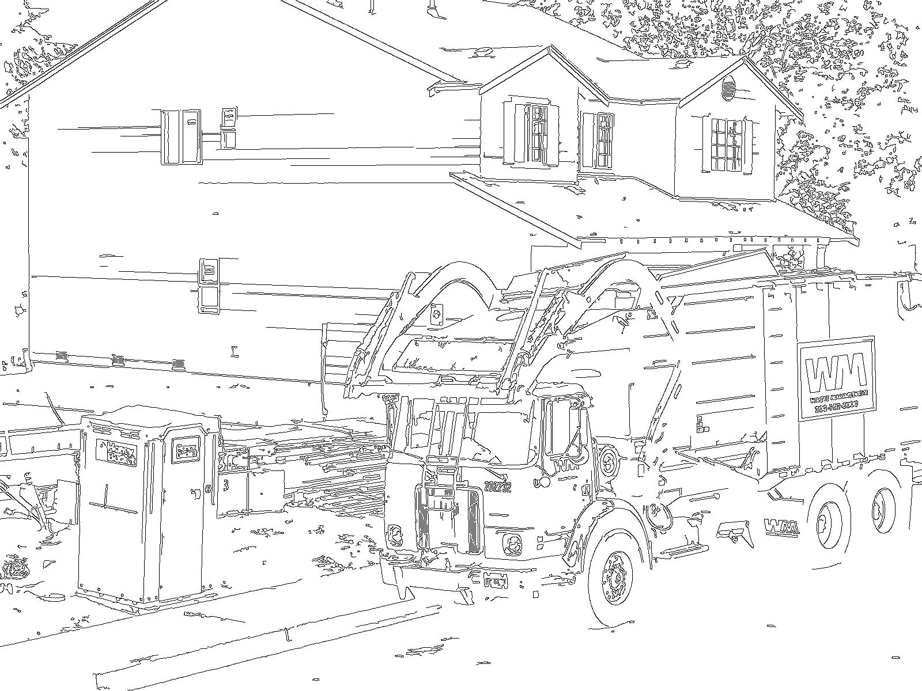


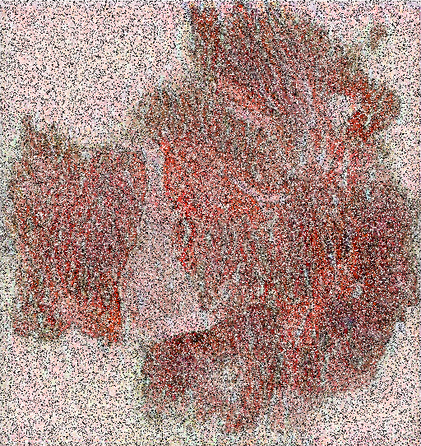
Scenarios & Conditions
Dark Vision / Shutter Malfunction (Silhouette)
Blurred Vision
(Lowpass)
Stains Effect
(Texture)
Production Error
(Rotate)
Bright Light / Shutter Malfunction (Edge)
Noise
Improper Fold
(Crop)
Texture + Noise + Rotate
Automated Driving
Medical Diagnosis
Abstraction of SCENARIOS that commonly affect image recognition
Notes:
Here, I would like to emphasis on the scenarios. Many existing studies demonstrate that machine learning algorithms have been observed to have “biases” for some scenarios which are observable for human. Interestingly, this does not conflict with the fact that AI and humans make judgments based on different criteria. For example, many image recognition algorithms are not good at recognizing blurred images. So, driving scenarios that produce blurred visuals (such as foggy or rainy days), may significantly affect the accuracy and efficiency of autonomous driving algorithms. The list of such scenarios actually goes on, we chose some of representative examples from autonomous driving and medical diagnosis for our user test, as shown here. For real-world cases, scenarios could be more complicated, there could exist one or more unique properties for one task. So, we further break down scenarios into the combination of one or more conditions, where conditions denoted the presence of one specific property of the task, such as the blurred visual we mentioned. Here we have an example, image in the lower right corner is the combination of multiple conditions which actually would exist in real-world cases. In this way, the scenario could be vectorized into binary vectors where 1 represents the existence of a condition.

Slide 7
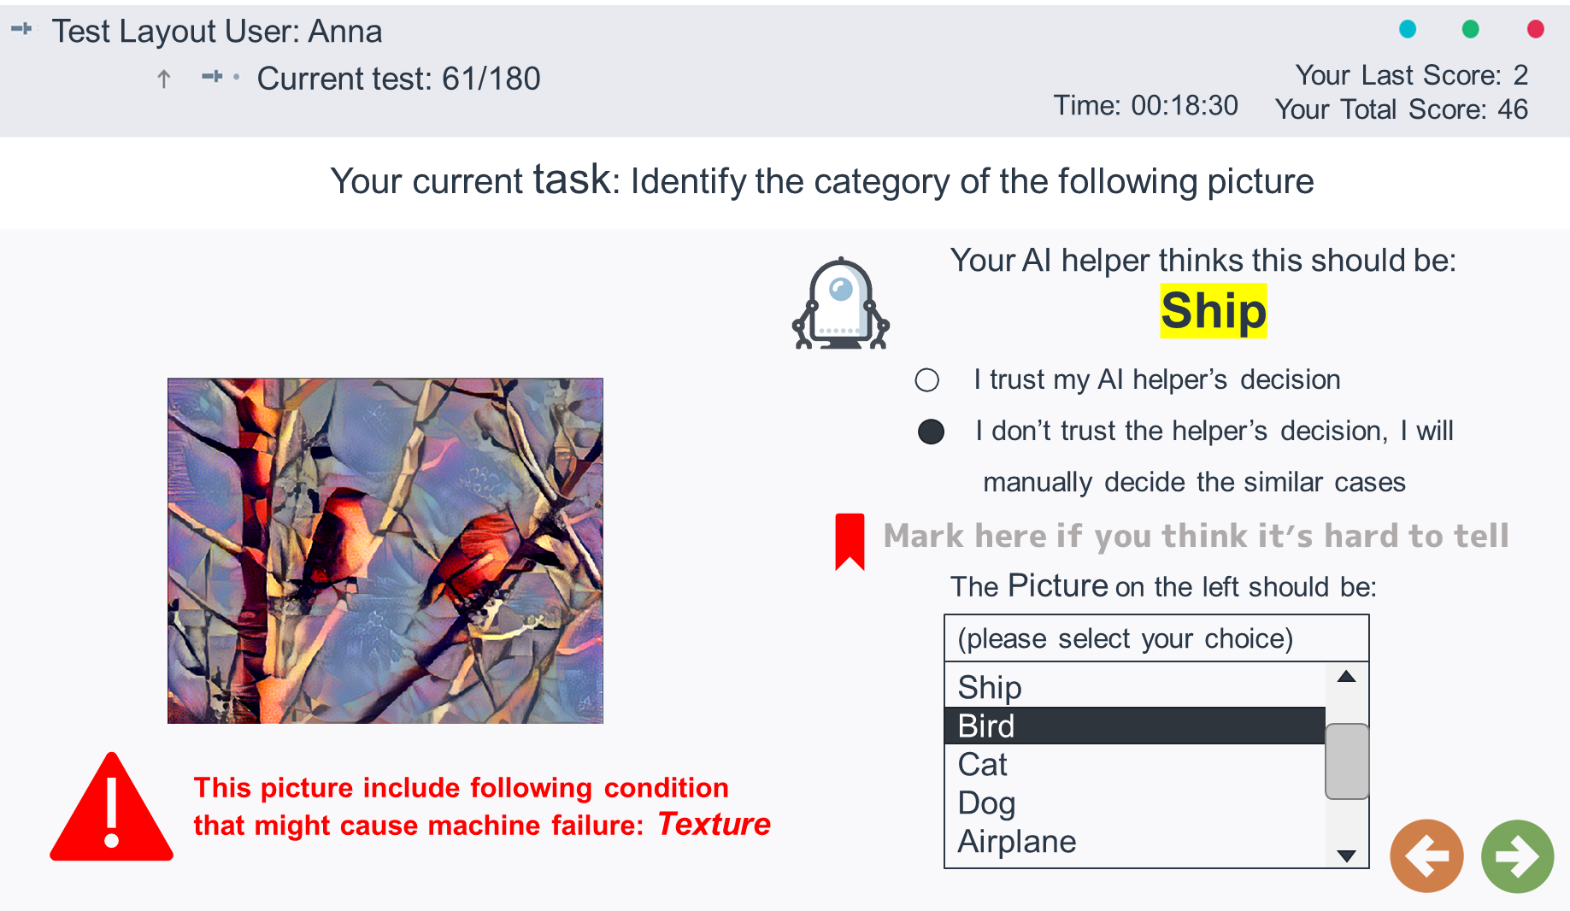
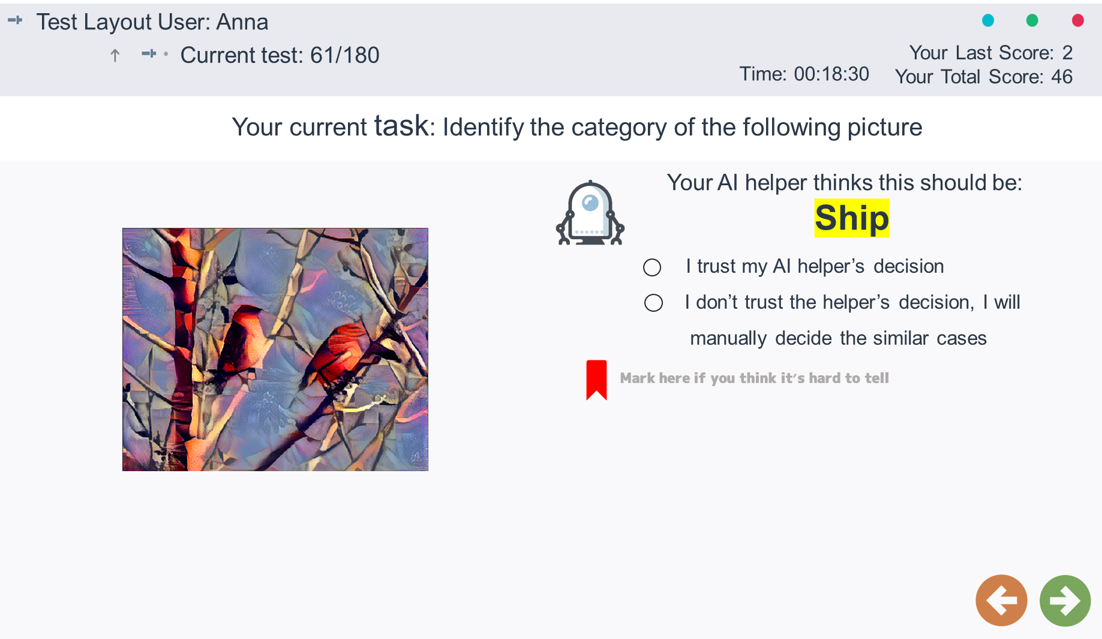
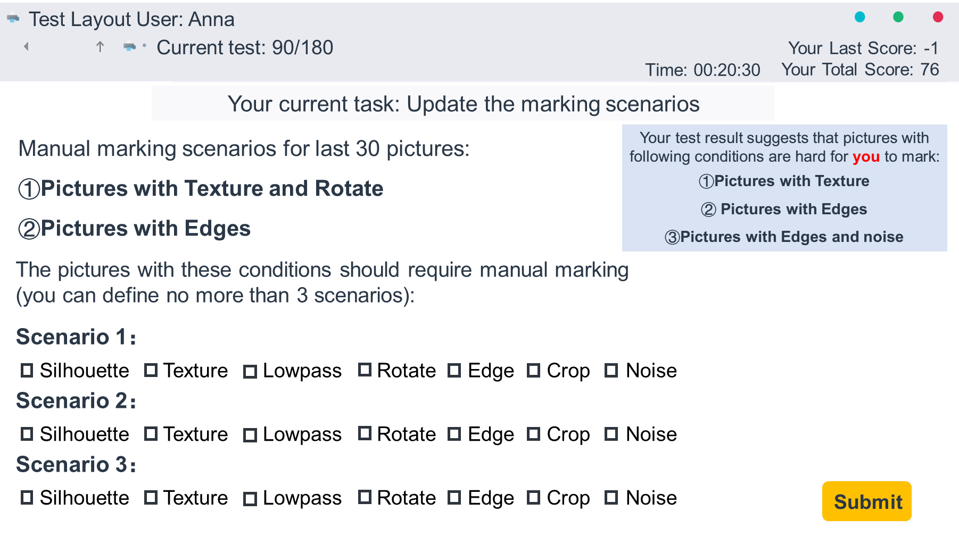
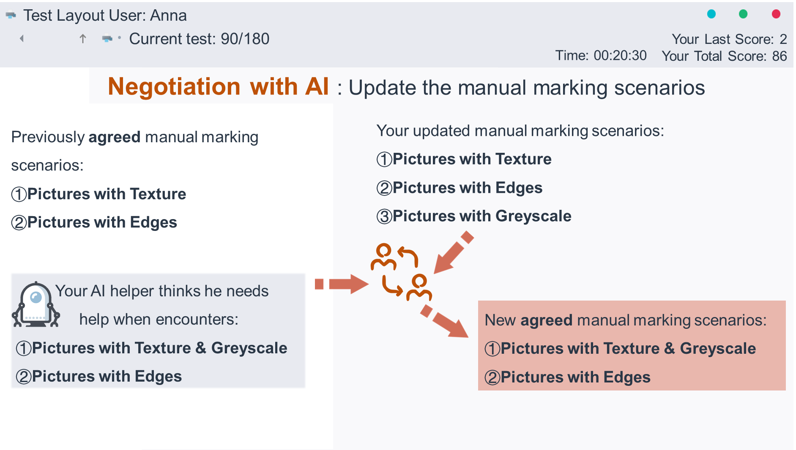

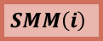
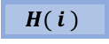
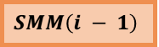
User Study – Evaluating Effectiveness & Usefulness
$$SMM（i − 1）$$
$$H( i )$$
$$A( i )$$
$$SMM（i）$$
Notes:
So, to test the designed mechanism, we designed a lab study. The main task is to correctly identify the objects in the picture through human-AI cooperation. But we applied the combination of the conditions here to the pictures for labelling.
For the experiment that build shared mental model for cooperation, the AI and user are required to enter negotiation sessions after every 30 pictures. And during the negotiation sessions, human and AI would both express their opinions of what kind of pictures they think human are better than AI to label, and we designed some negotiation methods to combine these opinions, then updated the jointly agreed opinions for task assignment. Then for the next session of labelling, when the picture satisfies the specific conditions, it will be highlighted for human to suggest them to label manually, and of course the not highlighted pictures would suggest human to adopt AI’s answers to save time.

Slide 8
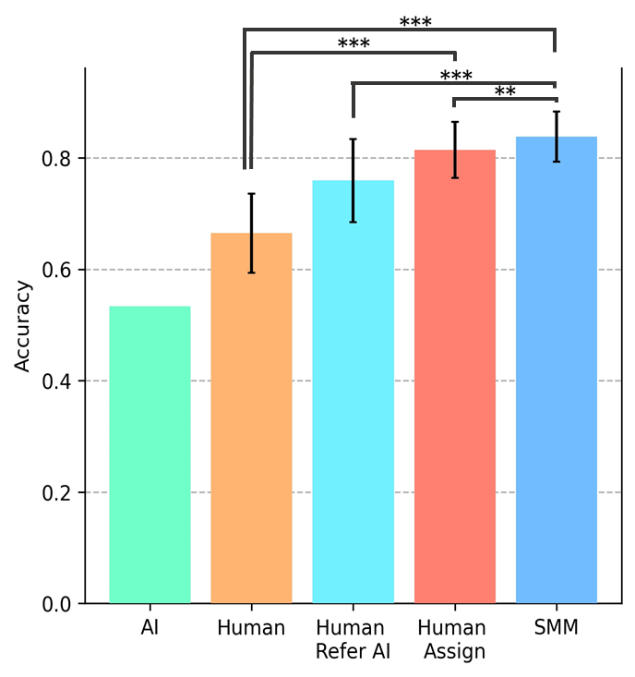
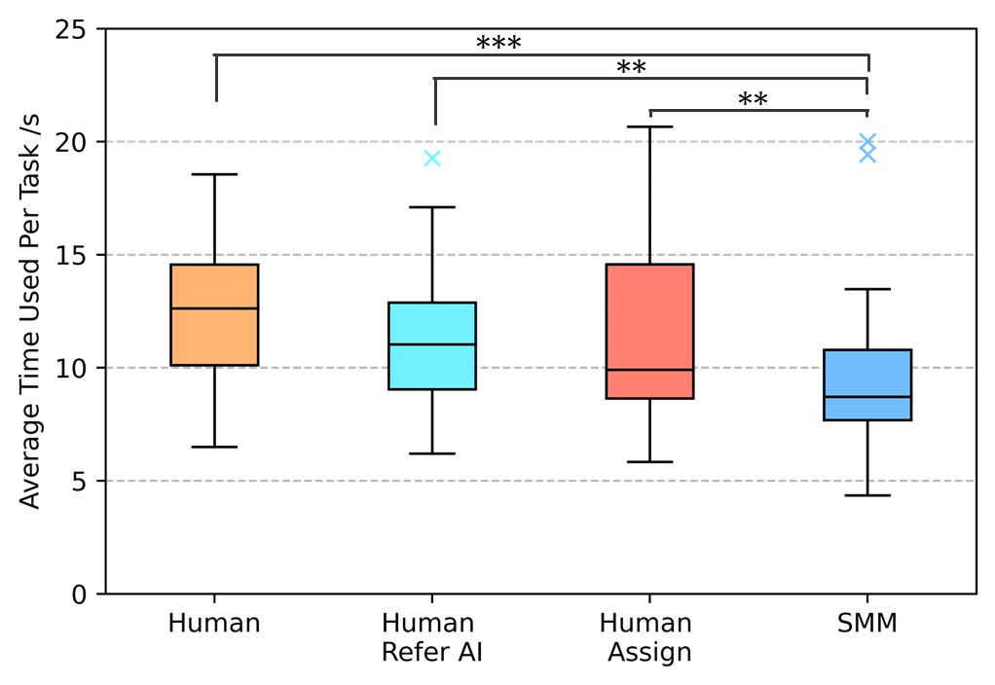
Results (Time & Efficiency)
Building SMM between human and AI (Human+AI+SMM) boosts the accuracy and time efficiency significantly.
Notes:
Here are some of the results we obtained through user test. We compare the work mode that human or AI complete the task on their own, the human makes final decisions for the tasks while referring to AI’s answers, the human decide the assigning of pictures and our shared mental model method.
Accuracy-wise, the work modes that human-AI teams work with shared mental model stand out the most.
Time-wise, human-AI teams with shared mental models require much less time per task as well.

Slide 9
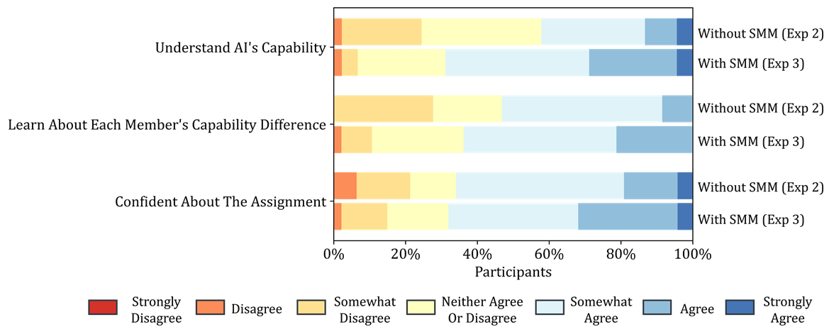
Results (Subjective)
Building SMM between human and AI help users better understand the human/AI capability.
Notes:
Also, the users were interviewed afterwards with a questionnaire, the subjective feedbacks also suggest that our setting help participants to realize the capability of AI and themselves, and are more confident of the task assignment throughout.

Slide 10
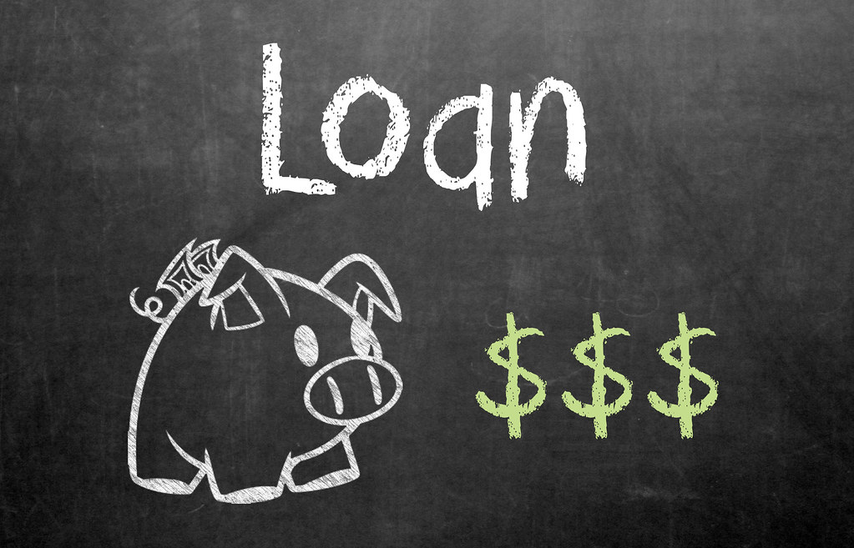
What Next…?
Other Tasks?
Other Variables?
Other Channels?
list of conditions
confidence of human or AI
the complexity of negotiation methods
eye movements
mouse movements
Notes:
So, what next?
The results give us inspirations to integrate such framework into other task assignment problems for human-AI cooperation. And for other tasks, we could extract properties other than image features, such as using the numeric features of specific applicants for loan approval as scenarios to build the shared mental model between loan approval algorithms and human operators.
Our framework is still under improvement for future works. For example, there are other variables that could be taken into consideration.
Such as the list of conditions, the confidence of human or AI
the complexity of negotiation methods
other interaction channels such as eye movements and mouse movements might also help to evaluate the engagement of the current user on the cooperation task.

Slide 11




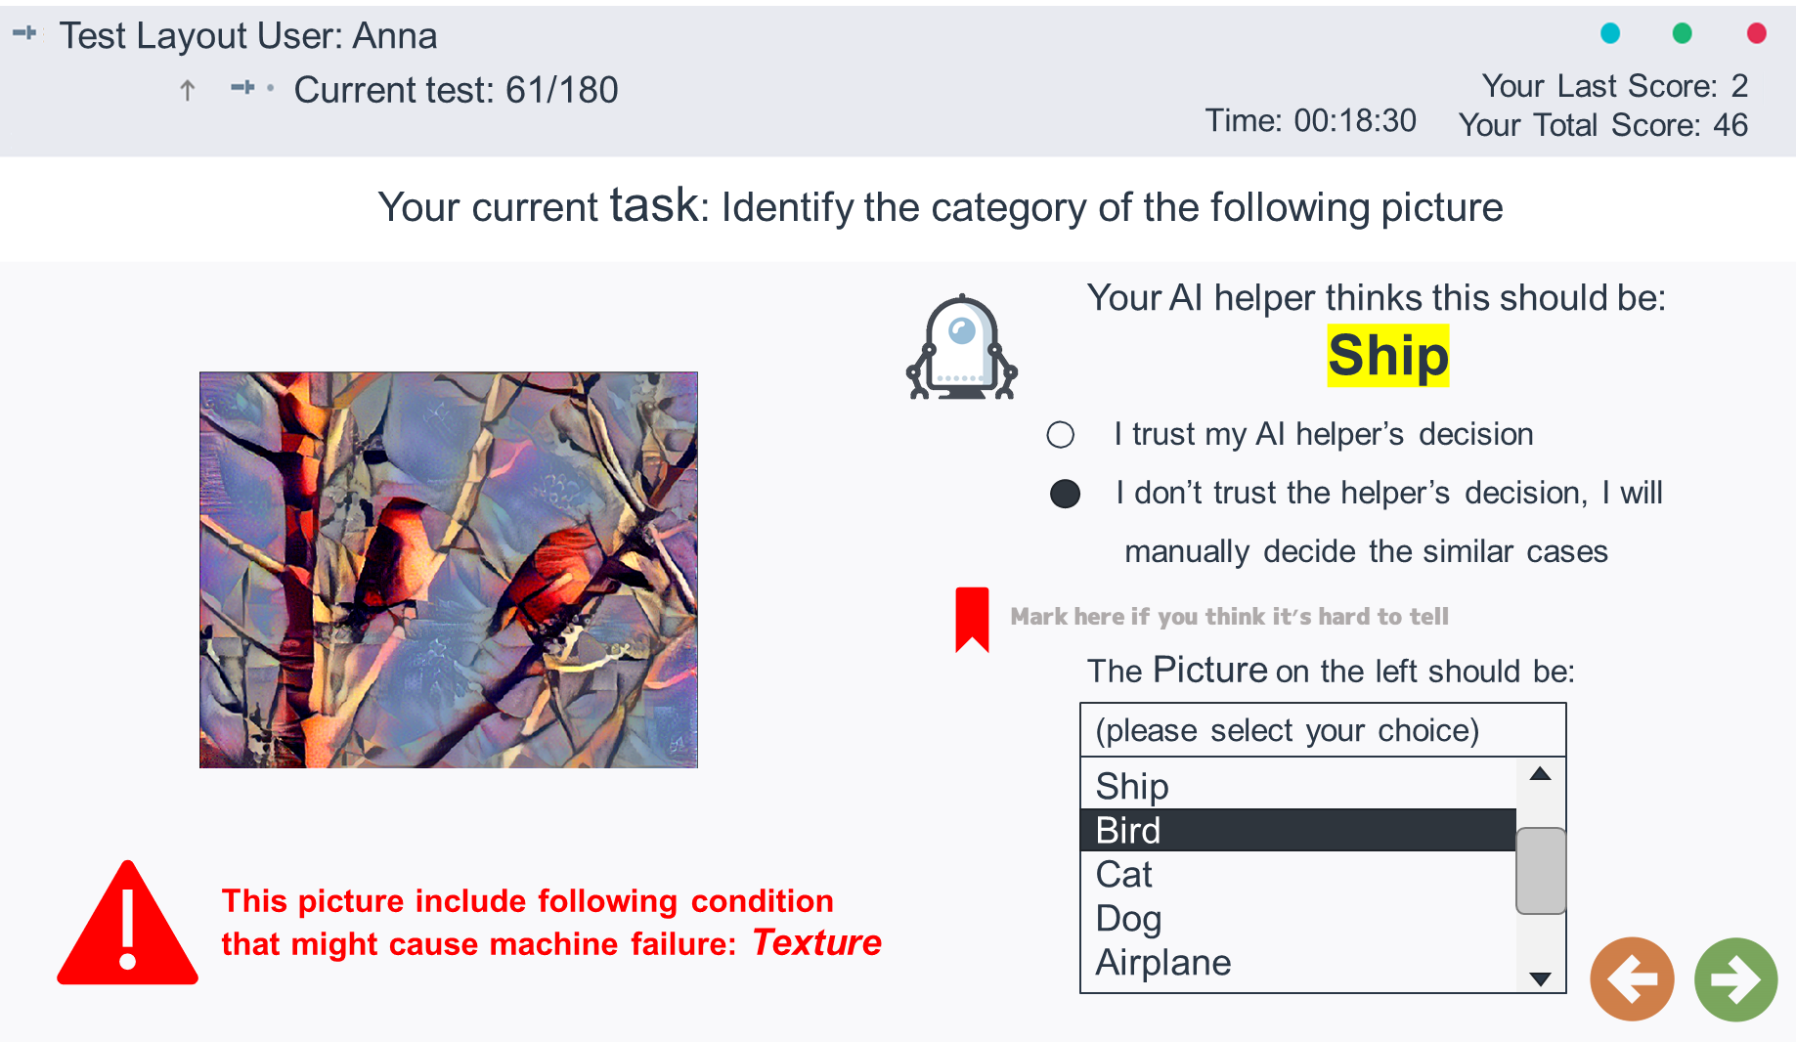
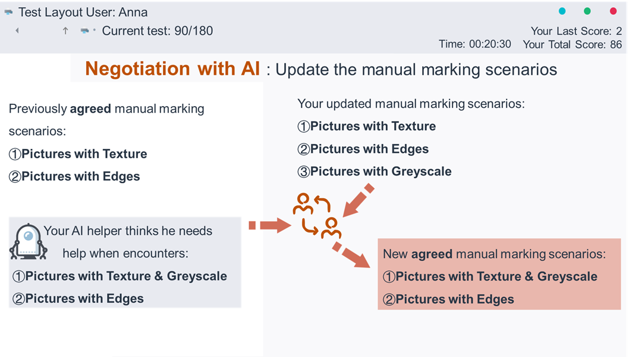
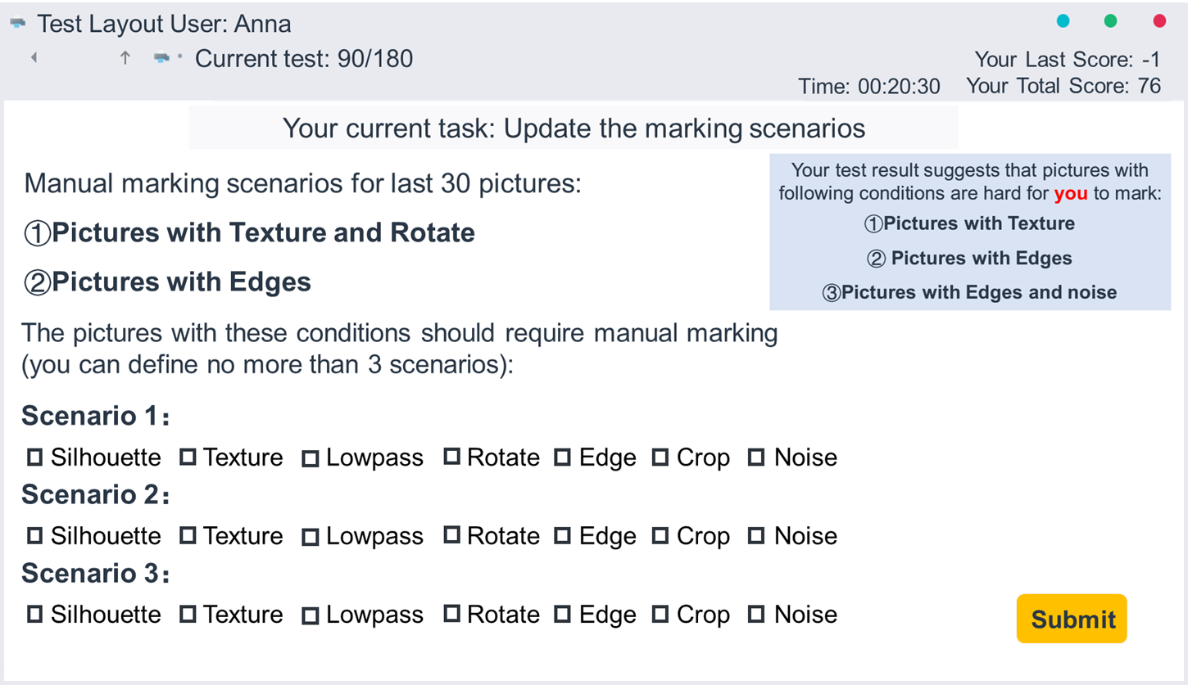




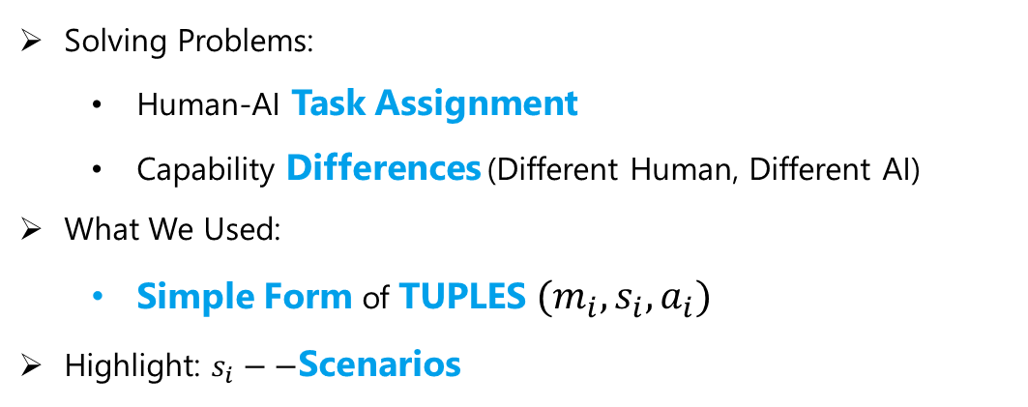
Summary
Interaction of Thoughts:
Towards Mediating Task Assignment in Human-AI Cooperation
with a Capability-Aware Shared Mental Model
Solving Problems:
Human-AI Task Assignment
Capability Differences (Different Human, Different AI)
What We Used:
Simple Form of TUPLES $(m_{i},s_{i},a_{i})$
Highlight: $s_{i}−−$Scenarios
User Test: Image Labelling with SMM
Building Capability-Aware SMM:
Boost accuracy and time efficiency
Form task assignment close to real capabilities
Help users better understand the human/AI capability
Notes:
More interesting details and some explanations could be found in our paper, I encourage the audience interested to read our paper and don’t hesitate to contact us, thank you all for listening!

Slide 12

Thanks for listening!!
Ziyao He: @Marsroscope
Zhongmin Cai: http://gr.xjtu.edu.cn/web/zmcai/english-version
Shurui Zhou: @shuishuiblue

Slide 13
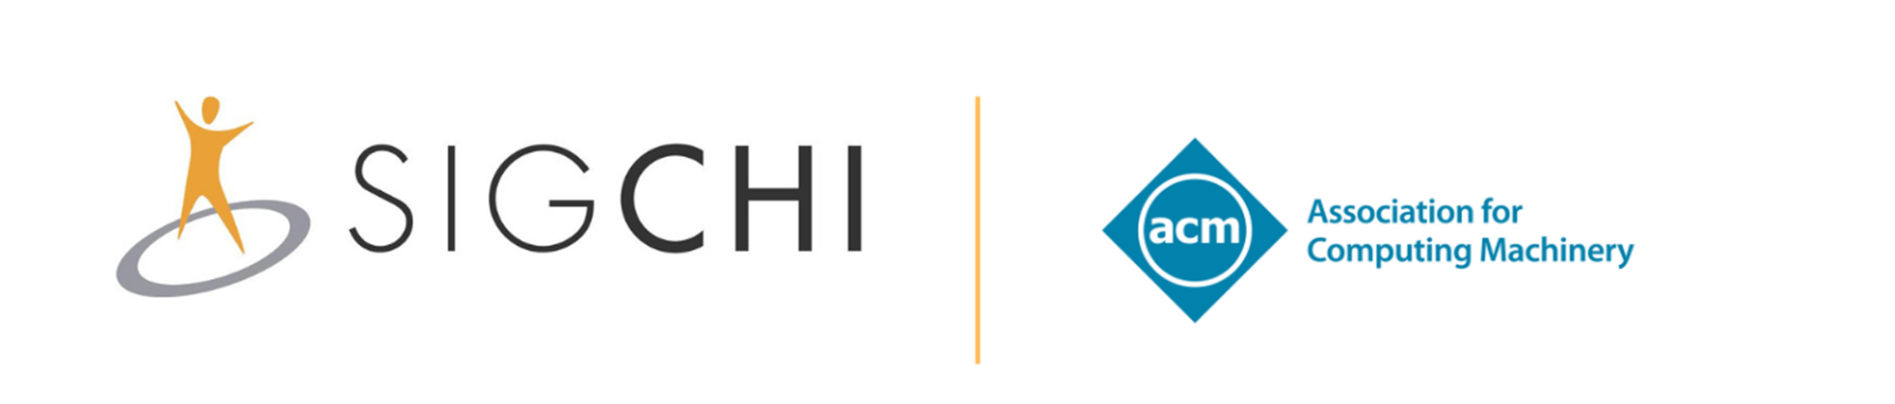
HAMBURG, GERMANY / APRIL 23 – 8,2023

